Slide 1



Starting Homebrewed Beer Bars that stands out in current market of Exported Beers
Data Analytics Project, Part 3, Final Report

Slide 2
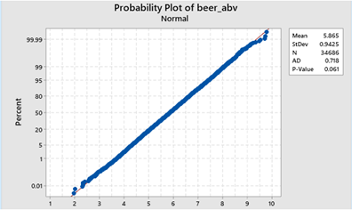
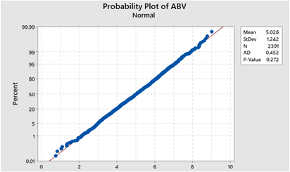
Normality Tests

Slide 3
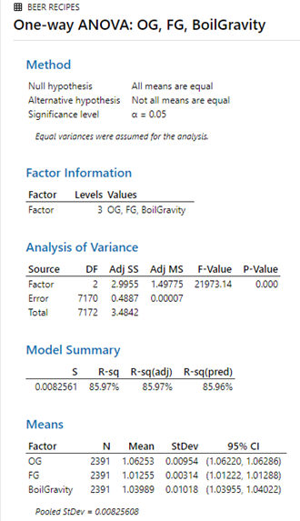
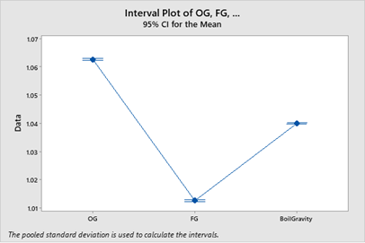
One - Way ANOVA Test

Slide 4
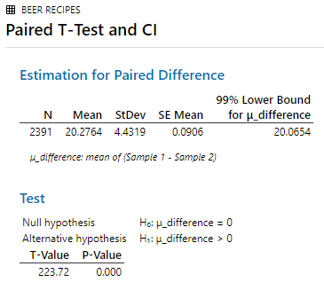
Paired - t Test

Slide 5
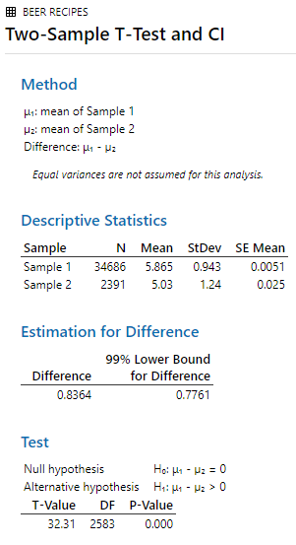
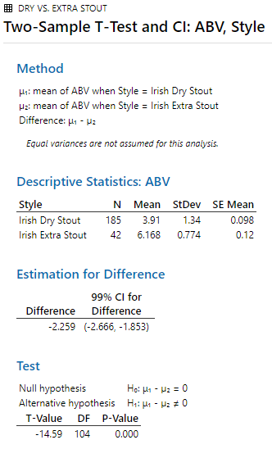
2 – Sample Tests

Slide 6
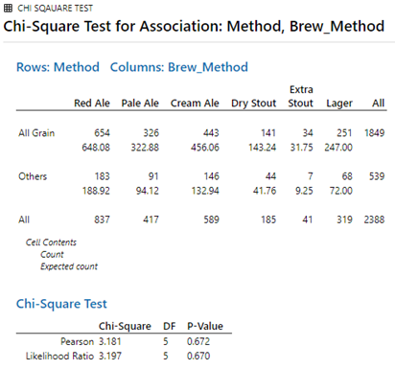
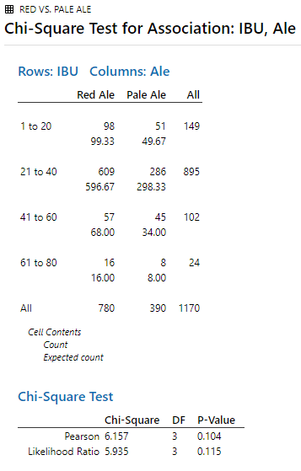
Chi – square Tests for Association

Slide 7
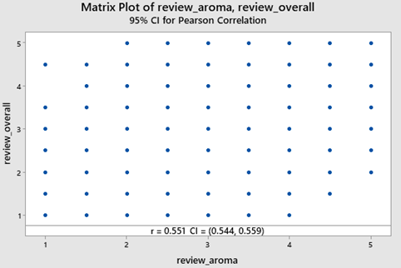
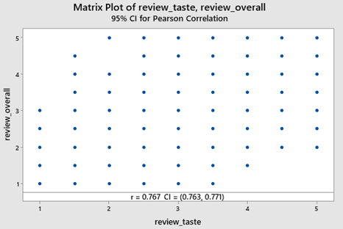
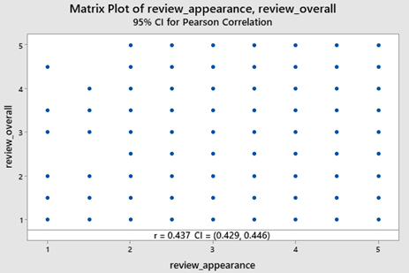
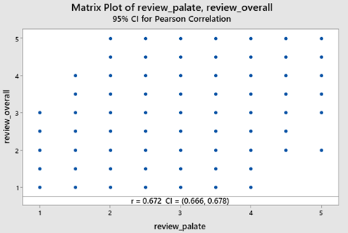

Slide 8

Shortlisted Beer Recipes
Rublin Ale (Irish Red Ale)
Friends of Pale (Irish Pale Ale)
Smithwick’s Cream Ale (Irish Cream Ale)
Sore Hands Milk Stout (Irish Dry Stout)
Jabeerini’s Irish Stout (Irish Dry Stout)
Irish Black Hag (Irish Extra Stout)
Yardsman’s Lager (Irish Lager)
review_average_weighted
=
(
(C_t * 'review_taste')
+
(C_ap * 'review_appearance')
+
(C_ar * 'review_aroma')
+
(C_p * 'review_palate')
)
/
C+

